Slide 1







Consuming REST Services from C#
Web Services & Cloud
SoftUni Team
Technical Trainers
Software University
http://softuni.bg

Slide 2



Table of Contents
Consuming Web Services – Overview
Using HttpClient
Asynchronous API with async/await
Using RestSharp

Slide 3
HttpClient
Modern HTTP client for .NET
Flexible API for accessing HTTP resources
Has only async methods
Using the new TAP (Task-based Asynchronous Pattern)
Sends and receives HTTP requests and responses
HttpRequestMessage, HttpResponseMessage
Responses / requests are accessed through async methods
Can have defaults configured for requests

Slide 4
Sending a GET Request
*Async().Result blocks the program until a result is returned
string GetAllPostsEndpoint = "http://localhost:64411/api/posts";
var httpClient = new HttpClient();
var response = httpClient.GetAsync(GetAllPostsEndpoint).Result;
var postsJson = response.Content.ReadAsStringAsync().Result;
Console.WriteLine(postsJson);
// [{"id":1,"content":"...","author":"peicho","likes":0},
// {"id":2,"content":"...", ... }]

Slide 5
Converting Response to Object
Microsoft.AspNet.WebApi.Client adds the ReadAsAsync<T> extension method
var httpClient = new HttpClient();
var response = httpClient.GetAsync(GetAllPostsEndpoint).Result;
var posts = response.Content
.ReadAsAsync<IEnumerable<PostDTO>>().Result;
foreach (PostDTO post in posts)
{
Console.WriteLine(post);
}
public class PostDTO
{
public int Id { get; set; }
public string Content { get; set; }
public string Author { get; set; }
public int Likes { get; set; }
}

Slide 6
Sending a POST Request
Manually set custom request header
var httpClient = new HttpClient();
httpClient.DefaultRequestHeaders.Add(
"Authorization", "Bearer " + "{token}");
var content = new FormUrlEncodedContent(new[]
{
new KeyValuePair<string, string>("content", "nov post"),
new KeyValuePair<string, string>("wallOwnerUsername", "peicho")
});
var response = httpClient
.PostAsync(AddNewPostEndpoint, content).Result;
...
Send data in request body

Slide 7
Building Query Strings
HttpClient does not support adding query string parameters
Can be done with UriBuilder and HttpUtility
const string Endpoint = "api/users/search";
var builder = new UriBuilder(Endpoint);
var query = HttpUtility.ParseQueryString(string.Empty);
query["name"] = "мо";
query["minAge"] = "18";
query["maxAge"] = "50";
builder.Query = query.ToString();
Console.WriteLine(builder);
// api/users/search?name=%u043c%u043e&minAge=18&maxAge=50
Escapes special characters

Slide 8

Simple HttpClient Requests
Live Demo

Slide 9

Asynchronous Programming

Slide 10
Synchronous Code
Synchronous code is executed step by step
10 static void Main()
11 {
12 int n = int.Parse(Console.ReadLine());
13 PrintNumbersInRange(0, 10);
14 Console.WriteLine("Done.");
15 }
16
17 static void PrintNumbersInRange(int a, int b)
18 {
19 for (int i = a; i <= b; i++)
20 {
21 Console.WriteLine(i);
22 }
23 }
int n = int.Parse(..)
PrintNumbersInRange()
Console.WriteLine(..)
...

Slide 11
Asynchronous Code
Asynchronous programming allows the execution of code simultaneously
static void Main()
{
int n = int.Parse(Console.ReadLine());
PrintNumbersInRange(0, 10);
var task = Task.Run(() =>
PrintNumbersInRange(10, 20));
Console.WriteLine("Done.");
task.Wait();
}
int n = int.Parse(..)
for (0..10)
Console.WriteLine(..)
for (10..20)
Wait()

Slide 12
Tasks with async and await
The keywords async and await are always used together
async hints the compiler that the method might run in parallel
Does not make a method run asynchronously (await makes it)
Tells the compiler "this method could wait for a resource or operation"
If it starts waiting, return to the calling method
When the wait is over, go back to called method
async void PrintAllPosts(string file, int parts)

Slide 13
Tasks with async and await (2)
await is used in a method which has the async keyword
Saves the context in a state machine
Marks waiting for a resource (a task to complete)
Resource should be a Task<T>
Returns T result from Task<T> when it completes
await PrintAllPosts("localhost:55231/api/posts");
Returns Task<string>

Slide 14
async and await – Example
static void Main()
{
PrintAllPostsAsync("localhost:55231/api/posts");
...
}
static async void PrintAllPostsAsync(string endPoint)
{
var httpClient = new HttpClient();
Console.WriteLine("Fetching posts...");
var response = await httpClient.GetAsync(endPoint);
var posts = await response.Content.ReadAsAsync<IEnumerable<PostDTO>>();
foreach (var post in posts)
{
Console.WriteLine(post);
}
Console.WriteLine("Download successful.");
}
The calling thread exits the method on await
Everything after that will execute when the *Async() method returns a result

Slide 15
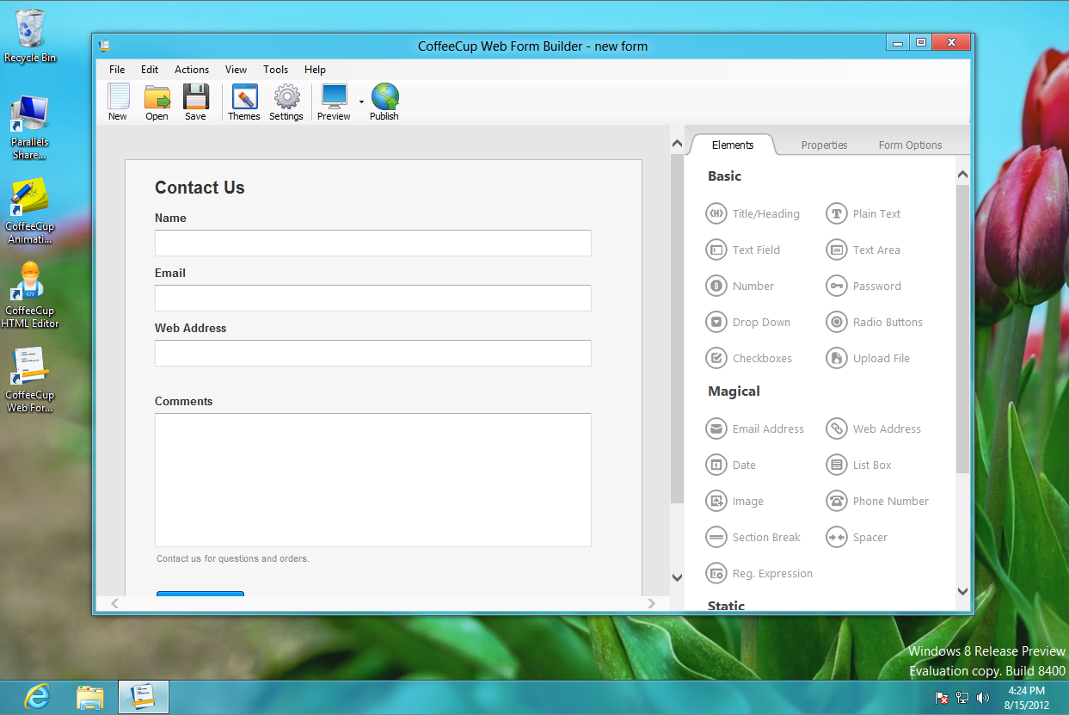
Graphical User Interface
Live Demo

Slide 16

RESTSharp

Slide 17
RESTSharp
Simple REST and HTTP API client for .NET
Supported in older versions of .NET (before 4.5)
Available in NuGet
var client = new RestClient();
client.BaseUrl = new Uri("http://localhost:37328/api/");
var request = new RestRequest("students/{id}", Method.GET);
request.AddUrlSegment("id", "5");
var response = client.Execute(request);
Console.WriteLine(response.Content);

Slide 18









Consuming REST Services with C#
https://softuni.bg/courses/web-services-and-cloud/

Slide 19
License
This course (slides, examples, demos, videos, homework, etc.) is licensed under the "Creative Commons Attribution-NonCommercial-ShareAlike 4.0 International" license
Attribution: this work may contain portions from
"Web Services and Cloud" course by Telerik Academy under CC-BY-NC-SA license

Slide 20






Free Trainings @ Software University
Software University Foundation – softuni.org
Software University – High-Quality Education, Profession and Job for Software Developers
softuni.bg
Software University @ Facebook
facebook.com/SoftwareUniversity
Software University @ YouTube
youtube.com/SoftwareUniversity
Software University Forums – forum.softuni.bg

